Slide 1
Mel-spectrograms Explained Easily

Slide 2
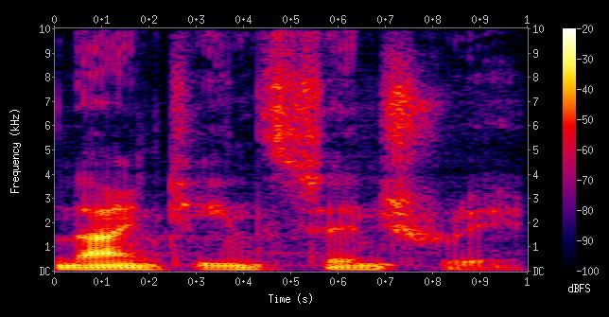
Previously...

Slide 3
We have a problem!
Humans perceive frequency logarithmically

Slide 4
Ideal audio feature
Time-frequency representation

Slide 5
Ideal audio feature
Time-frequency representation
Perceptually-relevant amplitude representation

Slide 6
Ideal audio feature
Time-frequency representation
Perceptually-relevant amplitude representation
Perceptually-relevant frequency representation

Slide 7
Ideal audio feature
Time-frequency representation
Perceptually-relevant amplitude representation
Perceptually-relevant frequency representation
Mel spectrograms

Slide 8
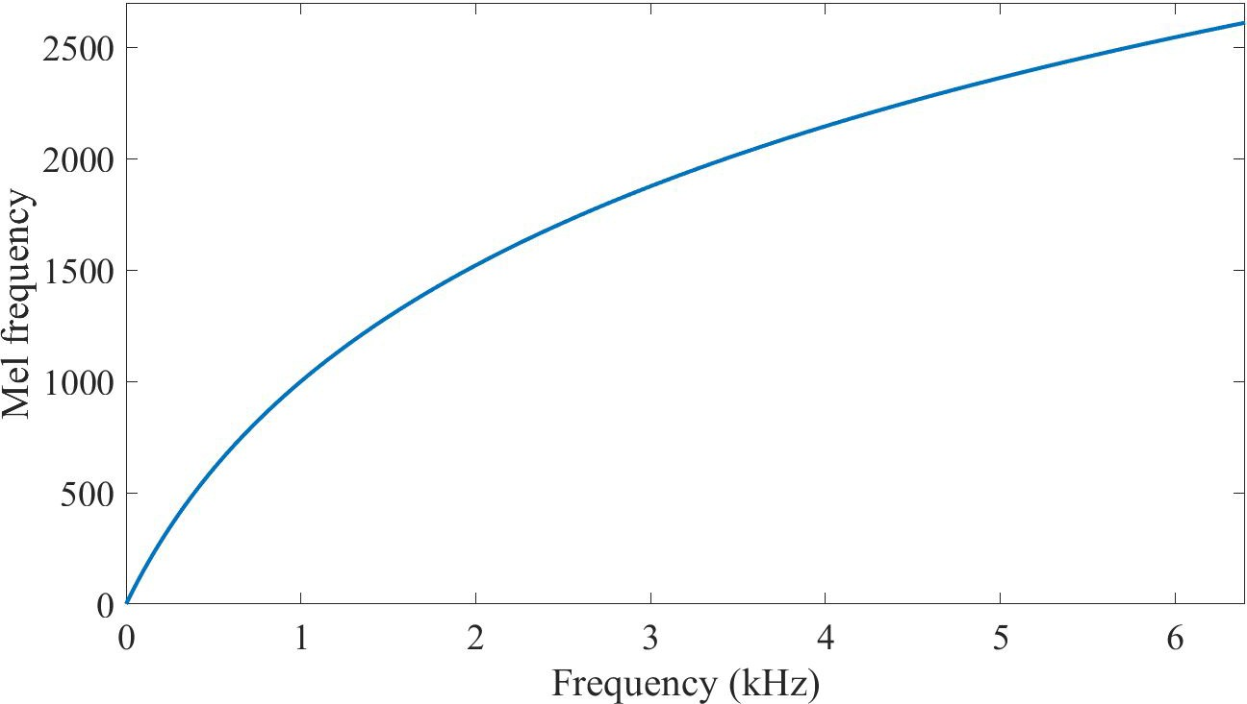
Mel-scale
Logarithmic scale
Equal distances on the scale have same “perceptual” distance
1000 Hz = 1000 Mel

Slide 9
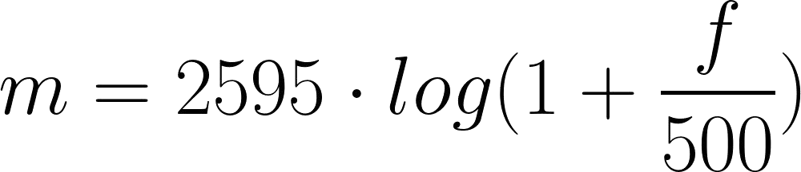
Mel-scale

Slide 10
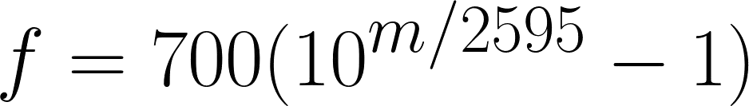
Mel-scale

Slide 11
Recipe to extract Mel spectrogram
Extract STFT
Convert amplitude to DBs
Convert frequencies to Mel scale

Slide 12
Recipe to extract Mel spectrogram
Extract STFT
Convert amplitude to DBs
Convert frequencies to Mel scale

Slide 13
Convert frequencies to Mel scale
Choose number of mel bands
Construct mel filter banks
Apply mel filter banks to spectrogram

Slide 14
How many mel bands?

Slide 15
How many mel bands?
40
128
60
90
It depends on the problem!

Slide 16
Convert frequencies to Mel scale
Choose number of mel bands
Construct mel filter banks
Apply mel filter banks to spectrogram

Slide 17
Mel filter banks
1. Convert lowest / highest frequency to Mel

Slide 18

Mel filter banks
Convert lowest / highest frequency to Mel
Create # bands equally spaced points

Slide 19

Mel filter banks
Convert lowest / highest frequency to Mel
Create # bands equally spaced points

Slide 20
Mel filter banks
Convert lowest / highest frequency to Mel
Create # bands equally spaced points
Convert points back to Hertz

Slide 21
Mel filter banks
Convert lowest / highest frequency to Mel
Create # bands equally spaced points
Convert points back to Hertz
Round to nearest frequency bin

Slide 22
Mel filter banks
Convert lowest / highest frequency to Mel
Create # bands equally spaced points
Convert points back to Hertz
Round to nearest frequency bin
Create triangular filters

Slide 23
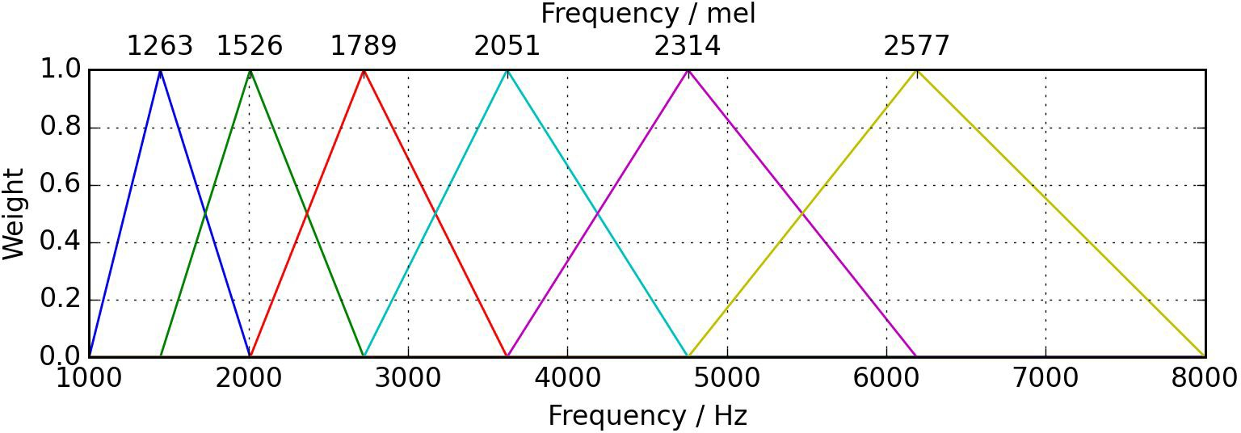
Mel filter banks

Slide 24
Mel filter banks’ shape
(# bands, framesize / 2 + 1)

Slide 25
Convert frequencies to Mel scale
Choose number of mel bands
Construct mel filter banks
Apply mel filter banks to spectrogram

Slide 26
Applying mel filter banks to spectrogram
M = (# bands, framesize / 2 + 1)

Slide 27
Applying mel filter banks to spectrogram
M = (# bands, framesize / 2 + 1)
Y = (framesize / 2 + 1, # frames)

Slide 28
Applying mel filter banks to spectrogram
M = (# bands, framesize / 2 + 1)
Y = (framesize / 2 + 1, # frames)

Slide 29
Applying mel filter banks to spectrogram
Mel spectrogram = MY

Slide 30
Applying mel filter banks to spectrogram
Mel spectrogram = MY
(# bands, # frames)

Slide 31
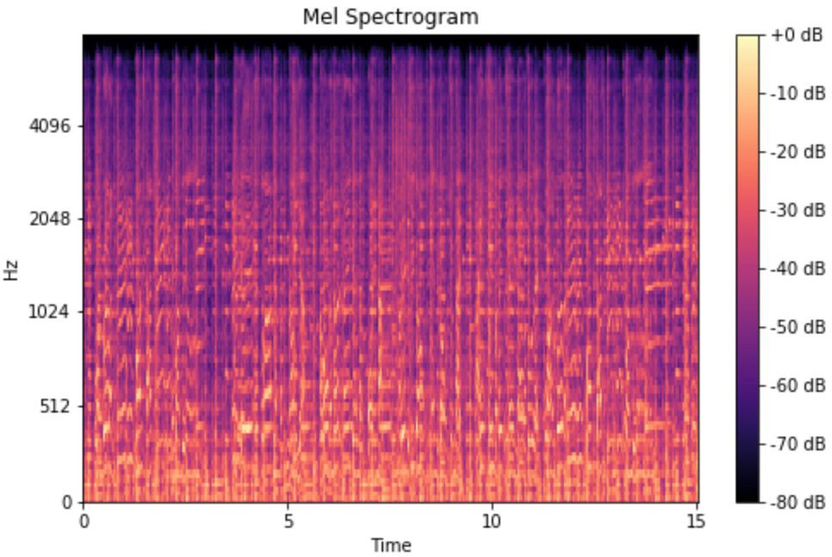
Applying mel filter banks to spectrogram

Slide 32
Mel spectrogram applications
Audio classification
Automatic mood recognition
Music genre classification
Music instrument classification
...

